Slide 1

Geometry
Unit 11, Lesson H1 Inscribing Polygons in Circles Volume 2, pg. 187

Slide 2


Benchmark
MA.912.GR.5.4
Construct a regular polygon inscribed in a circle. Regular polygons are limited to triangles, quadrilaterals, and hexagons.
volume 2, pg. 187

Slide 3
Integrated Mathematical Thinking and Reasoning Standards
MA.K12.MTR.1.1 Actively participate in effortful learning both individually and collectively.
MA.K12.MTR.2.1 Demonstrate understanding by representing problems in multiple ways.
MA.K12.MTR.4.1 Engage in discussions that reflect on the mathematical thinking of self and others.
MA.K12.MTR.5.1 Use patterns and structure to help understand and connect mathematical concepts.
volume 2, pg. 187

Slide 4

Learning Targets
I can construct an equilateral triangle inscribed in a circle.
I can construct a square inscribed in a circle.
I can construct a regular hexagon inscribed in a circle.
volume 2, pg. 187

Slide 5

Warm-Up
volume 2, pg. 187

Slide 6
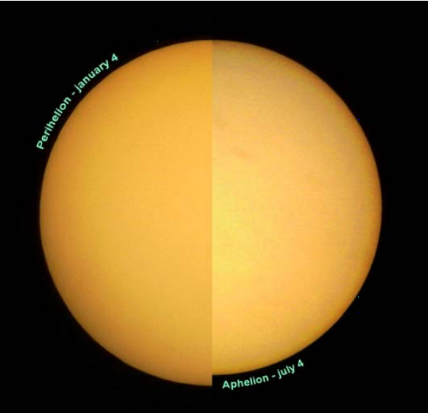
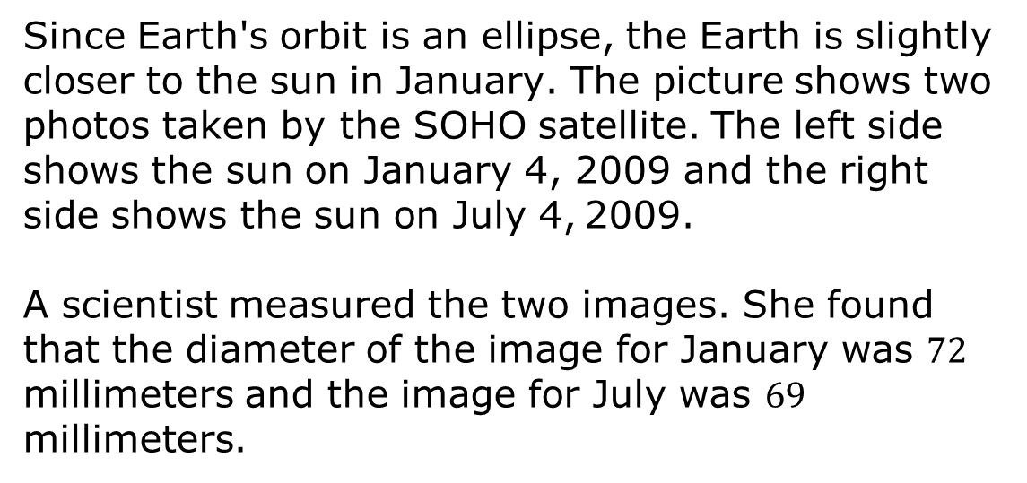
11.H1.1 Warm-Up: Earth’s Orbit
Since Earth's orbit is an ellipse, the Earth is slightly closer to the sun in January. The picture shows two photos taken by the SOHO satellite. The left side shows the sun on January 4, 2009 and the right side shows the sun on July 4, 2009.
A scientist measured the two images. She found that the diameter of the image for January was $72$ millimeters and the image for July was $69$ millimeters.
volume 2, pg. 187

Slide 7
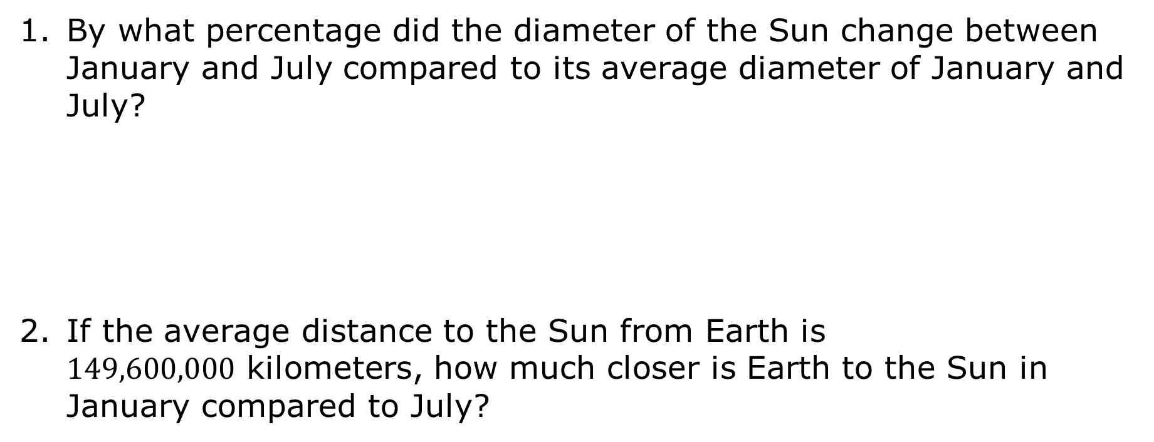
By what percentage did the diameter of the Sun change between January and July compared to its average diameter of January and July?
If the average distance to the Sun from Earth is $149,600,000$ kilometers, how much closer is Earth to the Sun in January compared to July?
volume 2, pg. 187

Slide 8

Activity
volume 2, pg. 188

Slide 9

11.H1.2 Activity: Regular Polygons Inscribed in Circles
Work with your partner to answer each question. Use the larger copies of each polygon provided by your teacher.
Use a compass to draw a circumscribed circle for each polygon.
Mark the center of the circle that was drawn on the polygon. Draw a central angle that passes through two subsequent vertices, as shown.
volume 2, pg. 188

Slide 10
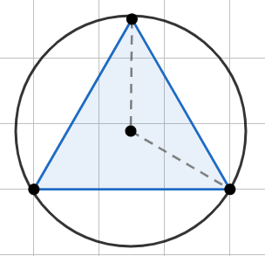
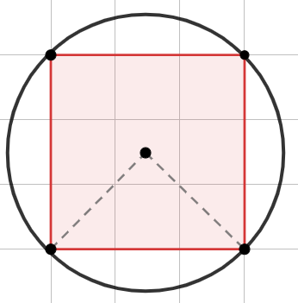
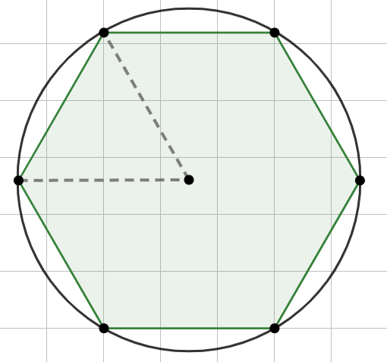
Triangle | Square | Hexagon
Use a protractor to determine the measure of each central angle.
 | Triangle | Square | Hexagon
Measure of Central Angle
volume 2, pg. 188

Slide 11
Make a conjecture about how to construct each regular polygon inscribed in a circle using a compass and a straight edge.
 | Construction
Triangle
Square
Hexagon
volume 2, pg. 188

Slide 12
Ask another pair of partners for the conjectures they wrote. Listen to their conjectures and write a summary. You are the only person who should write in the first three columns of the table. Have the person initial next to your summary stating that your summary was accurate.
Review your conjectures with your partner and if necessary, make any changes.
 | Other Partner Pair’s Conjecture | Other Partner Pair’s Initials
Triangle
Square
Hexagon
volume 2, pg. 189

Slide 13
Activity
volume 2, pg. 189

Slide 14
11.H1.3 Activity: Card Sort
Sort the sets for each construction. Then, write the steps in the table.
 | Construction Steps
Triangle Method 1
Square Method 1
volume 2, pg. 189

Slide 15
 | Construction Steps
Hexagon Method 1
Triangle Method 2
volume 2, pg. 190

Slide 16
 | Construction Steps
Square Method 2
Hexagon Method 2
volume 2, pg. 190

Slide 17

Wrap-Up
volume 2, pg. 191

Slide 18
11.H1.4 Wrap-Up: Cool Down
Write an explanation to a classmate who might have missed today’s lesson, in your own words, about inscribing polygon in circles.
volume 2, pg. 191

